Slide 1
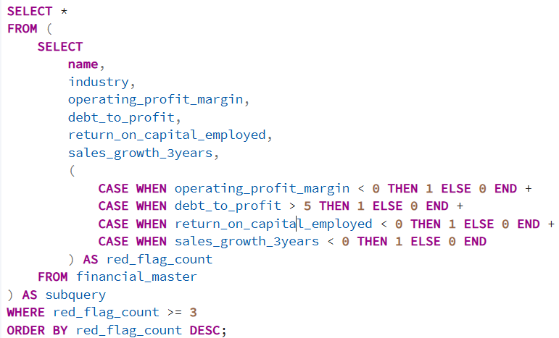
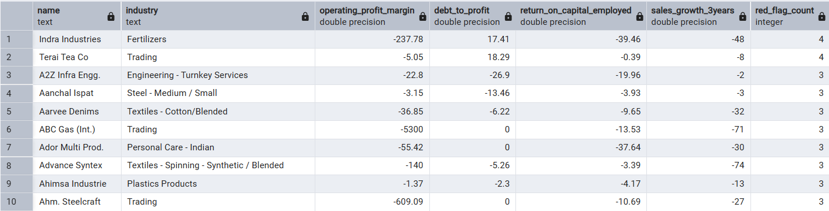
RISK & RED FLAGS
Question: Which companies have 3 or more simultaneous red flags — negative OPM, high debt, low ROCE, and negative growth?
Query
Output
Recommendation:
Exclude all 3+ red flag companies from any investment screener immediately — risk-reward is un-favorable.
Use this list as a short-selling watchlist or distress monitoring basket
Follow up with Altman Z-Score cross-check — high overlap expected with distress zone companies
Observation:
All listed companies carry exactly 3 red flags — none reached all 4 simultaneously
Indra Industries and Teral Tea Co. show extreme negative OPM alongside negative ROCE and negative sales growth
Textile and Trading sectors appear repeatedly — suggesting sectoral stress rather than isolated company failures
Insight:
Presence of 3 simultaneous red flags strongly indicates structural distress, not cyclical downturn — these companies lack pricing power, carry excess debt, and are shrinking
Textile sector vulnerability reflects competition from cheaper imports and rising input costs squeezing margins from both ends
Trading companies with negative OPM suggest they are selling below cost — possibly to maintain market share or service debt obligations

Slide 2
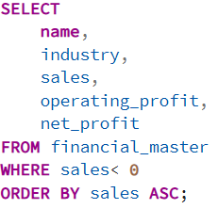

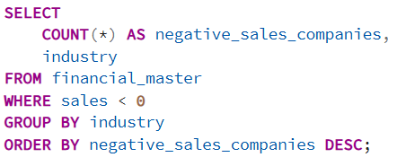

Question: Companies with negative sales — is this a data quality issue or genuinely revenue-negative companies?
Query
Output
Query
Output
Recommendation:
Treat negative sales companies as un-investable from fundamental analysis perspective — no revenue base to build valuation on
Flag for regulatory check — SEBI filings should confirm whether revenue recognition follows proper accounting standards
Remove from ratio-based screening models as negative sales distort all margin and valuation calculations
Observation:
Only 1 company — Gogia Capital (Finance & Investments) — shows negative sales of -20
Operating profit and net profit are also negative, confirming this is not a data entry error
Negative sales count by industry shows Finance & Investments as the only sector affected
Insight:
In financial services, negative revenue can legitimately occur when trading losses, fee reversals, or mark-to-market losses exceed gross income — this is a real business scenario
Gogia Capital being a small Finance & Investments entity suggests it may be an investment holding company that booked net losses on portfolio positions
Single company occurrence confirms this is not a dataset quality issue — it is an edge case reflecting genuine financial distress

Slide 3
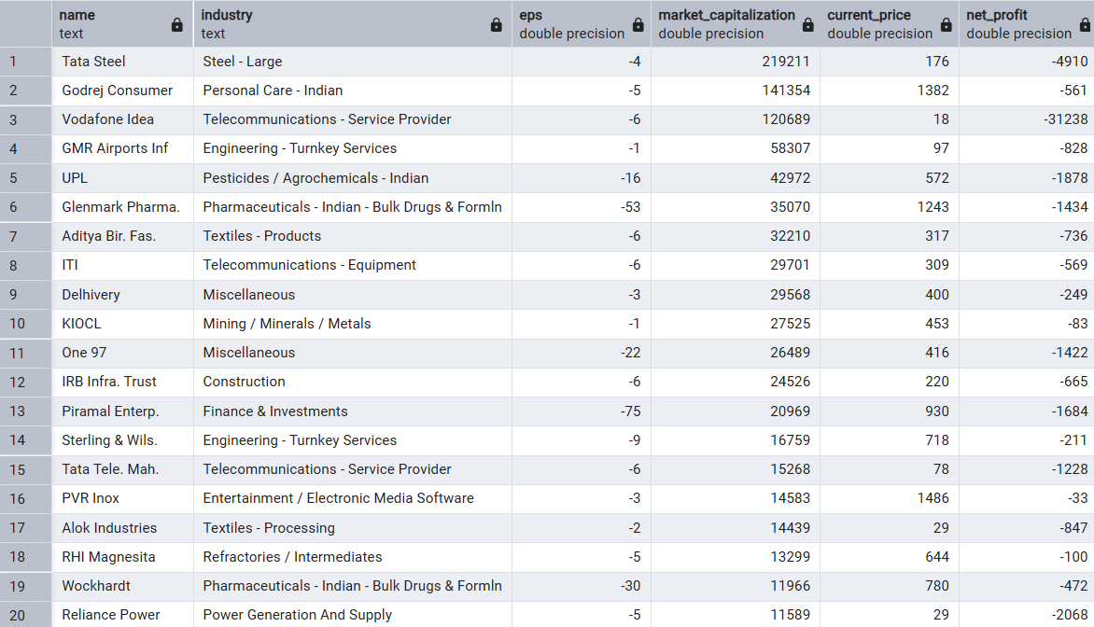
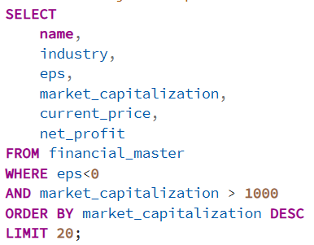
Question: EPS negative companies — what is their market cap? Are any zombie companies loss-making yet overvalued?
Output
Query
Observation:
Tata Steel and Vodafone Idea lead with highest market caps despite negative EPS — both are large-cap distressed names
Several mid-size companies like GMR Airports, Adani Biz. Fac., and IBI Infra Trust carry significant market caps with deeply negative net profit
Reliance Power at the bottom still commands ₹11,589 Cr market cap despite persistent losses
Recommendation:
Avoid all EPS-negative high market cap companies unless a credible turnaround catalyst exists — earnings visibility is zero
Vodafone Idea and Reliance Power specifically carry existential risk — position sizing should reflect binary outcome probability
Cross-reference with promoter pledging data — high pledge + negative EPS + high market cap is the most dangerous combination
Insight:
Large-cap zombie companies like Vodafone Idea survive on market perception of "too big to fail" and potential turnaround narratives — not fundamentals
Infrastructure and Telecom sectors dominate this list — both are capital-intensive with long gestation periods, justifying some market patience
Retail investor sentiment and speculative trading often keep loss-making companies overvalued far beyond what fundamentals support

Slide 4
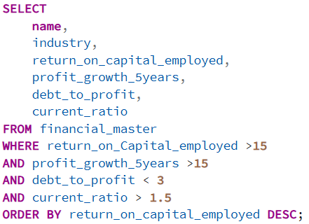
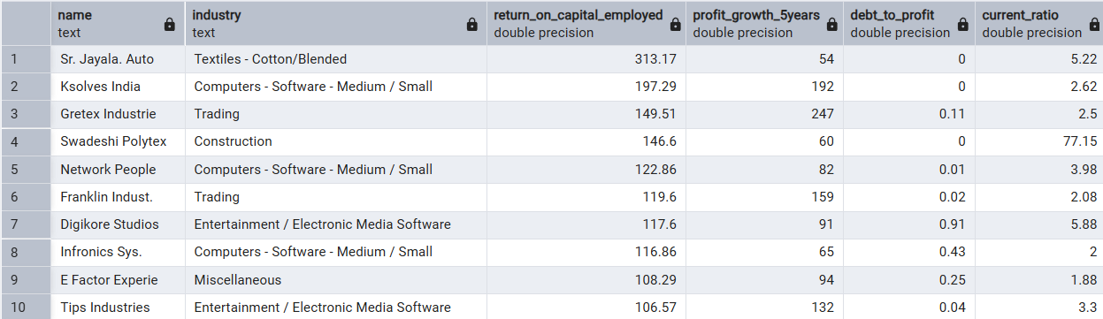
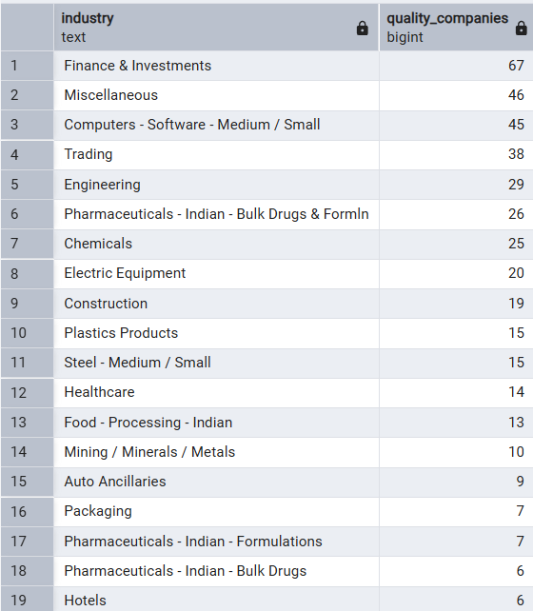
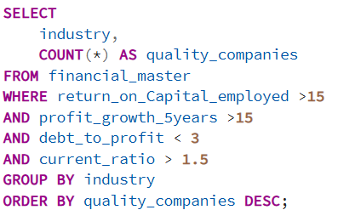
Question: Build a Quality Growth screener — ROCE > 15%, Profit Growth 5Y > 15%, Debt-to-Profit < 3, Current Ratio > 1.5 — which companies pass?
Query
Output
Output
Query
Observation:
Only a handful of companies pass all 4 filters simultaneously — confirming quality growth is rare in Indian markets
Finance & Investments and Computers Software sectors contribute most qualifying companies
All passing companies show ROCE well above threshold with manageable debt levels
Recommendation:
This screener output is a ready-made high-conviction watchlist — prioritize deeper fundamental research on these names
Add dividend yield or free cash flow filter to further refine — quality companies that also return cash are the strongest long-term holds
Insight:
The rarity of companies passing all 4 filters confirms that sustainable quality growth with financial discipline is a genuine competitive moat
Software sector dominance reflects asset-light business models — low debt, high returns, and consistent profit growth are structural advantages
Companies clearing this screener have demonstrated they can grow profitably without compromising balance sheet health — rare combination

Slide 5
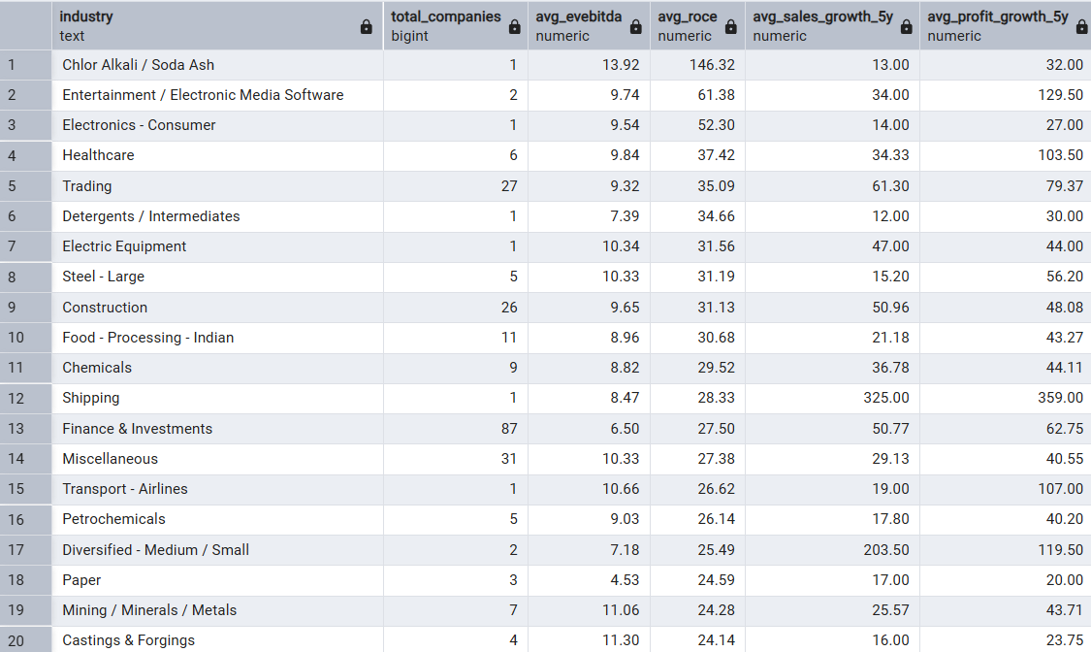
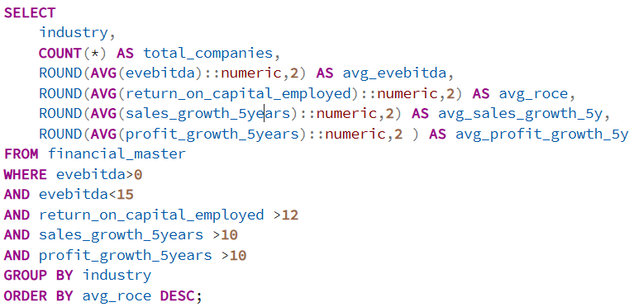
Question: Sector rotation perspective — which sectors have reasonable valuation (EV/EBITDA) and strong fundamentals for next 3–5 years?
Output
Query
Observation:
Chemicals, Electronics Consumer, and Healthcare appear with favorable EV/EBITDA alongside strong average ROCE and profit growth
Finance & Investments shows up with high company count but average metrics — driven by sheer sector size
Steel and Construction appear with moderate valuations but lower growth consistency
Recommendation:
Overweight Chemicals and Healthcare for next 3–5 year sector rotation — both offer growth at reasonable valuation with strong fundamental backing
Treat Steel and Construction as tactical plays only — buy on deep corrections, exit on valuation expansion
Build a sector-level EV/EBITDA tracking dashboard — rebalance allocation when any sector's average crosses 20x as valuation buffer shrinks
Insight:
Chemicals sector benefits from China+1 sourcing shift — global buyers diversifying supply chains are driving structural demand growth in Indian specialty chemicals
Healthcare combines defensive characteristics with export growth potential — US generics recovery and domestic chronic disease burden support multi-year earnings visibility
Electronics Consumer is an early-stage growth sector — government PLI schemes are compressing the investment cycle and accelerating domestic manufacturing scale-up

